Slide 1
Signposts
INNOVATIVE
SOLUTIONS
THAT
PEOPLE
VALUE
Presented by Robert Taylor, CEBS, CFP, CLU, CH.F.C.
TRG Group Benefits & Pensions Inc.
October 1, 2018

Slide 2
Tier 2
Integration
NCBA
G19
Stop Loss
Unclaimed
Property Act
Advisor
Risk
Compression
Fee Compression
CLHIA
National Pharmacare

Slide 3

G19
Notes:
Update-
CLHIA as we all know is in a reflective phase at the moment where they are trying to determine the best course of action from here.
We all know and have heard them say over and over again that they screwed this up royally. In my opinion those words ring very hollow. CLHIA (principally the big 3) have lost a lot of credibility and certainly trust from the advisor community.
They have had a string of miscues and they continue to illustrate their inability to consult with stakeholders beyond themselves and their utter disregard for the consumer. From Stop Loss and the EP3 fiasco, in my opinion the very undermining of the feeling that RISK is insured to a feeling today of KNOW THY INSURER well and know your plan sponsor risk tolerance better before you make a recommendation. To the G19 event. And to today, they have decided to initiate a fear mongering campaign to incite the masses to rally on the National PharmaCare policy. Forgive me but CLHIA’s track record is not very comforting of late and the latest foray if you haven’t seen it please go visit betterhealthbenefits.ca
Not sure I would sign the petition though.
Back to G19. The string of broken promises on “collaboration” over the period of an entire year was staggering beyond anything we have ever seen. The depths of the failure of our industry leaders was enough to shake many of us to the core. If the leaders could behave this flagrantly. To use their own lens to cloud over the needs of every other stakeholder, then what else is possible?
The way many of the members bashed each other in public was another interesting wrinkle in this saga.
The genesis of G-19 was “if we don’t do this, the regulatotors will” is such a specious argument. That they would embark on the 18 month journey of G19 hanging to the thread of “ the regulators will do it if we don’t”.
We know now that this was NOT on the regulators radar at all. This is a B2B transaction.
But the reasons maybe are not that important at the end of the day. The fact is CLHIA has placed them in a self absorbed bucket. Consumed with their own mandate to spite of the real stakeholder here which is the consumer.
G19 would or will result in higher costs for the consumer or at the very least no savings, advisor compression and thus less access for the consumer and the smaller end of the market likely left underserved and represented.
And that might be what the goal is here. Disrupt the smaller end of the market where much of the margin exists.
G19 issues remain and summed up easily- Context, level playing field (definition of intermediary, Tier 2 advantage with overrides and non contingent commissions, TPA loop hole, direct case compensation etc) and timing.
Context: consumers when told what we are paid do not have context for whether that is reasonable and customary or not. Not all advisory firms are created equal. There needs to be context for the consumer so they can assess what scope of services are linked to what compensation schedule. The insurers have all the data for the context and with some work could provide the context for the marketplace
Level playing field: G19 as it is proposed will give unintended advantages to different parts of the market- direct cases with insurers (advisors subsidizing insurer direct business), TPA’s (the ones where the insurer do not know who the sponsor or customer is), and the new Tier 2 folks who are eerily silent on G19. New Tier 2 is Gallagher’s, People Corp, NFP and HUB to name a few. The term ‘Non Contingent’ monies is something I learned in recent months. These large entities who have concentrated or heavily weighted in force premium blocks with insurers cary much more influence than any of us in the room. That equates to monies paid on a “non contingent” basis. Who pays for those money transfers? Our clients that’s who.
Timing: we are where we are based on decades of practices. Whether we like where we are today or not is only part of the problem or issue. If we want to get to a better place of transparency, then the industry needs time to transition to the new world. And not a matter of months. The industry needs years to transition approrpriately. Which brings me to my final observation on various miscues by CLHIA-
The miscue of CLHIA might be that its not about what we get paid that is the problem (I mean in a B2B transaction, does the business consumer need to be told what the intermediary is making from the manuacturer?? There has never been an example of thisin any other business). The very problem through the consumer lens is “How we are paid and incentivized”. Maybe the industry is ripe for a change in how insurers incentivize distribution and more importantly how insurers pay for that incentivization and allocate for it among all consumers.
Again, an error in judgement. Insurers inability to gaze beyond their navels may have miscalculated what the issue really is. It is not what I make but how I get paid that may be more of the issue from the consumer standpoint.
If insurers cannot incentivize, will that change the playing field? And have they thought this through? It does not appear that they have.
Back in January when we changed the terms of how we would interact with insurers and thereby take away some of their levers to incent me and my business, I was met with refrains such as “well how are we gong to do our job if we cannot meet with you?”.
My response was, that is your business. I am just trying to run my business and I have enough on my plate trying to figure out without trying to solve your problems.
So G19 still has the same 3 issues- context, playing field and timing. And until those issues can be addressed effectively with any move to transparency will be opposed as best as we can.
And at the crux of the issue here is one thing: You cannot prove the interests of the consumer were met with G19. Period.
So the next time CLHIA makes a comment like “we will look after the consumer”, beware. That is not their job. That is our job. We are the stewards for the consumer keeping them safe.
I will make one final comment on G19 before moving on. Mike is in the room who represents TPAAC. I must commend them for their submission and response to CLHIA. They publicly came out and stated their opposition to G19. That took a lot of gumption. I mean they are affiliated with CLHIA and so to stare down the beast with a well articulated letter was pretty cool. If you have not read their submission, please get a copy of it and read it. I really do think think it was an incredible well laid out response and for anyone trying to gain insight into some of the issues with G19, you would be well served by taking the few minutes to read it.

Slide 4

NCBA
Notes:
With the unpredictability of CLHIA coupled with the where the benefits industry finds itself, there appears to be the need for advocacy and awareness for the benefits community. Clearly the organizations today that deal with advisor advocacy are CALU and Advocis. They both do amazing work.
There is a significant But. Both organizations do not understand benefits. They are predominately oriented around the individual consumer. Is not an indictment. Its just a simple fact. The individual advisor and many other stakeholders (even many consumers) are uninformed. Many consider what a benefits advisor does as peddling a “commodity” and spread sheeting lowest price. Maybe that is what many of us did 10-15 years ago. And maybe unfortunately still many advisors are limited to this skill set today. But for many who specialize in benefits, Benefits like individual insurance has morphed considerably. And the path to sustainability and superior client outcomes is not done with a spreadsheet. Far from it. It is intentional and based on a very complex puzzle.
It is time that the benefits arm of financial services, get represented in the manner that respects and promotes what we do. Most stakeholders (including regulators) do not understand the role of the benefit advisor. Licensing doesn’t recognize it for crying out loud.
So, NCBA stands for National Coalition of Benefit Advisors. It’s a placeholder name for now while we go down the journey of formalizing. The initial steps in Q1 of 2018 was to create awareness within our community of what was happening with G19. We wanted to take off the CLHIA filter and give ourselves awareness and context for what G19 was and wasn’t using our lens and the lens of the consumer. Not some nonsense about we better do this lest the regulators do it.
We moved from awareness to soliciting interest from the advisor community and for people to give a little bit of information about themselves so we could create a very rudimentary data base and distribution list which stands at about 400 strong today.
We are now in the phase where we have had some preliminary discussions among a core group of benefit advisors as well as with Advocis. The goal is to explore the creation of a formal association of group benefit advisors.
Here are some prelim thoughts:
We do not want a single issue model (this might be an obvious statement but I wanted to make it) but a sustainable entity with distinction for the group benefits subset of the financial services sector. We are hoping to be represented as an entity with our own skill set or expertise- some sort of autonomous model with its own governance
This separate group of advisors would establish its own mandate and prioritize its own issues
It would make sense to utilize existing infrastructure of an Advocis as an example. Perhaps a separate branded entity within Advocis (think of GAMA as an example) with its own board made up of benefit advisor peers with the autonomy to establish its own governance and priorities with access to a budget through Advocis infrastructure and funded through identified benefit advisors
Explore possibility of various membership categories within advocis if possible to create this new entity
Perhaps a distinct website footprint for benefit advisors
Where are we:
-Advocis board has met and agreed to proceed with steps to consider making this happen
We are in process of identifying a working group of 6-8 individuals to work on our end to walk through he steps to create this entity
We need to consider how CALU could integrate with this as well

Slide 5

Stop Loss
Notes:
EP3 continues to be an issue.
It has created a two tiered system. The problem with it is that most advisors do not understand the consequences of EP3 and the industry is doing a very poor job of highlighting the possible risks for the consumer.
Stop Loss is not transparent. There is no consistency on approach or pricing. And there is no set rules or outcomes understood within the refund model of business. The range of risk among insurers is from moderate/mid level risk to catastrophic.
Advisors need to be more aware of this and I believe CLHIA members have a fiduciary obligation to the canadian consumer to have a much more robust governance model around how stop loss is sold or purchased.
If the rules have changed and the risk is severe with an insurer, this needs to be known and highlighted within the process of sale.

Slide 6
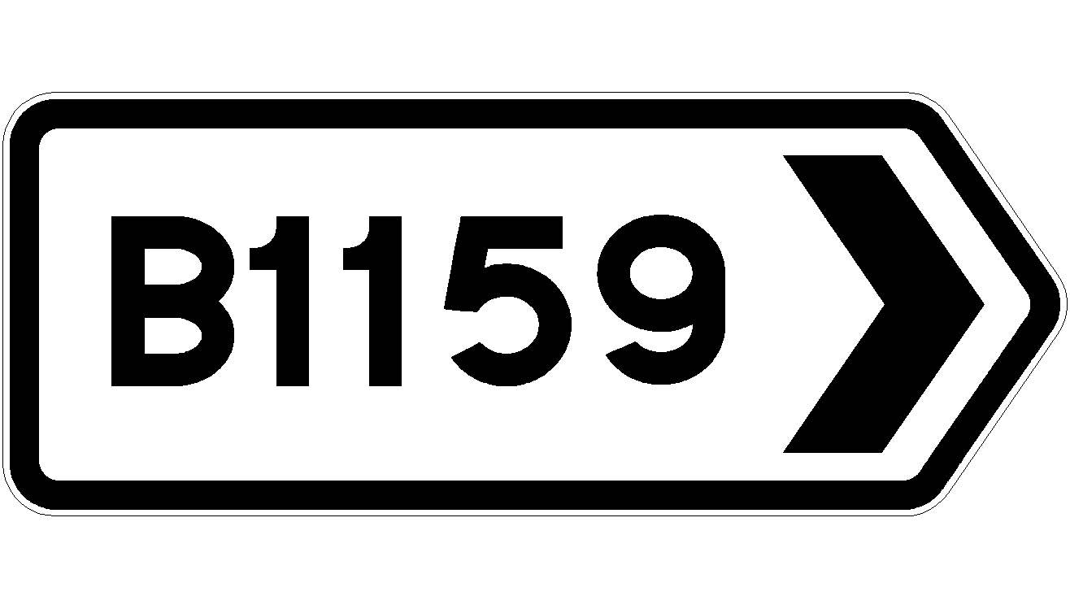
National Pharmacare
Notes:
This should really fall under the heading of Public Policy-
This may be the next big issue we are faced with. We had taxation of benefit plans a couple years ago, to the full on assault to small business last year and it continues today with the minor tweaks from V 2 and 3 and now National Pharmacare. We seemed to have moved into an era that anything for power. Anything to get votes. Maybe it has always been like this. But it cannot help but feel when marginal income taxation moves above 50% in most provinces combined with pandering to the voter with ever more spending ideas, that we have morphed into unprecedented territory. Ot an area where we have only seen a moment or two briefly in our history.
The point is- we should take heed.
Understanding the Gap Report – Analysis conducted by the Conference Board of Canada investigating the breadth of prescription drug coverage in Canada
Key Stat – 5.2% of Canadians are uninsured for prescription drugs. As of Jan 2018, this fell to 1.8% with the launch of OHIP+ in Ontario.
We need to all be aware that this will get traction quickly and we will have to be ready for this next battle. It is very real.
The House of commons released a report a couple weeks ago. It is over 120 pages long entitled:
Pharmcare Now: Prescription Medicine Coverage For All Canadians
This was authored by the Standing Committee on Health.
They seemed to have arrived rather quickly to the conclusion that a single payor system is best. Incase you are wondering what that means- it means one payor. The government. As in no private payor system. I will say that again for emphasis- no private payor system. As in about 25% of current group health premiums being diverted from group benefit plans to a government system.
The fed liberals held their national convention a few weeks ago in Halifax where they were voting and crafting political strategy for the next election. This item was moved to the top of the list for political benefit. National Pharmacare apparently polls as the strongest “soundbite” or worth the most politically. And the liberals committed to it as their number one priority and something where they have basically stated they want to take this policy away from the fed NDP party and own it themselves for their benefit.
It doesn’t matter that this would cost 20B and also that most canadians are already covered for drugs. It is about politics and power. And if it polls well, it will take on a life of its own. So we will have another battle onour hands soon.
The issue here for many of us is battle fatigue. The voice of a few having to take the lead and charge on another front.
And what do we prioritize? This one will be important.
There are some consultants

Slide 7

Risk
Notes:
The general feeling that risk for the consumer is increasing while risk for the insurer is decreasing. The very premise of insurance is being challenged.
Advisors need to have robust approach to ascertaining and documenting client tolerance for risk and ensure the product match is appropriate.

Slide 8

Advisor
Consolidation
Notes:
Expected acceleration of advisor departure from benefits business- multi faceted
Underlying much of it is the feeling by many that maybe it is time to ‘cash out’. Take the biz value off the table. That maybe the feeling is that we have hit the high point, and with not as many younger people coming in the industry, perhaps time is now.
Trust factor between CLHIA and distribution has probably never been lower
The career path of a qualified benefits consultant (and the ones who only do benefits??). It is more often an individual who gradually becomes a benefits person. Starting out as the dabbler and their revenue stream (due principally to the recurring organic revenue growth nature of benefits) growing over time to a position where benefits have become a significant portion of their business. Will that model of creating benefits advisors continue? TRG model of mentoring benefit practitioners is almost unheard of in Canada

Slide 9





Slide 10

Tier 2
Notes:
Which leads into emergence of a different entity that will accelerate advisor consolidation. And this is the irony of G19 and whatever the big 3 have up their sleeves.
It was stated face to face by CLHIA that whatever unintended consequences G19 would have on the industry, that would be fine and the market will determine the fate of the market.
What is extremely frustrating and unacceptable is that its not market forces. It is CLHIA through their poor decision making that is driving outcomes as much as anything. So if the big 3 have their eye on additional revenue streams and possibly disrupting distribution some way or another, they likely did NOT count on them causing their unintended consequences of the emergence of a NEW and much larger TIER 2 category in distribution.
Let me back up for a second. In our firm we got into the habit of classifying advisory firms. Basically by depth and breadth. A rudimentary class system for sure where we placed AON/Hewitt/Morneau/Mercers in the Tier 1 category. In the Tier 2 we placed firms who specialize in group benefits predominately or have a significant block or revenue stream in group benefits (revenues generally in todays dollars, in excess of 2M annually) and more often than not do NOT do personal or individual planning work.
And then Tier 3 which is everyone else who might have multi disciplinary practices and smaller group benefit practices.
The playing field within distribution may follow suit and change if other jurisdictions in the world are an indicator at all.
If CLHIA thought that disruption or evolution within distribution was a natural course of events, I do believe they miscued and erred in their judgement and dare I say maybe did not take heed of the lessons from other jurisdictions. I say this because the emergence of this new Tier 2, will create more difficulty for insurers who have an insatiable appetite for additional revenue streams and profits.
Power within a few on the distribution side will create pressures and a playing level that will be difficult for people who were once tier 3 and are now tier 4. And insurers will long for the days and their margins from tier 3 players.

Slide 11

Fee
Compression
Notes:
With disruption there will always be a segment of the market that will get commoditized. Even segments of the scope of services offered will get commoditized.
We are seeing this today. Some advisors with transparency will make it their value proposition to simply undercut what others charge. There are still the lion share of sponsors who do not understand the complexity of benefits sustainability and don’t understand how scope of service beyond spread sheeting will deliver the outcome they require.
There is an outfit today who are offering rudimentary renewal services, negotiating and report generation for a modest 1-2%. If that is the value porposition of many advisors today, you can see where fee compression could be rapid and painful for many.

Slide 12

CLHIA
Notes:
Parliamentary Budget Report: Federal Cost of a National Pharmacare Program – Analysis of investment required for Federal Government to implement a National single payer prescription drug program.
Key Stat – Cost to implement a National Pharmacare Program would be approximately $20.48
As a resource, CLHIA has recently launched an awareness campaign that provides a high level overview of the issue at www.betterhealthbenefits.ca
I am not sure what CLHIA is doing anymore. They seem to be adrift and running from one miscue in search of the next miscue.
One thing is for sure- the climate has changed and that relationship and mood has been altered for many years. Think about the banks for a second. And when the banks were trying to “tear down the pillars of finance” and sell insurance in their branches. The insurers scarred us into believeing banks were bad and not to be trusted. They did an amazing job. So much so, how many in the room have a significant amount of business with rbc since they got into the health benefits biz?
My point is, advisors have a very long memory. RBC or the banks are in a time out so to speak still with many advisors. And that’s like 25 years and counting.
The damage has been done with G19 and the world or relationship has been altered.
Now some of us after we are done lamenting and grieving that state, should feel liberated and our time has been freed!

Slide 13
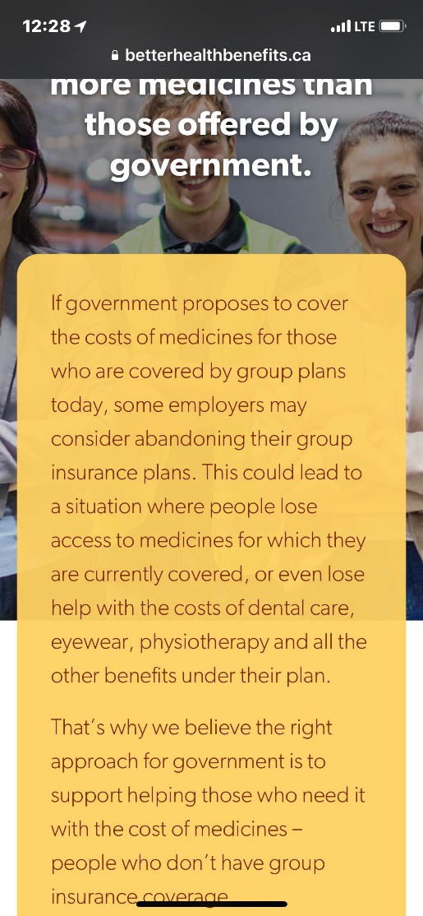
Notes:
Here is the site. Check it out. I am not political strategist. But it seems again misguided for the insurance industry to espouse fear mongering of this level. From where I sit, I think they are playing into the polling numbers and sound bites for the politicians. I would think a soft lobby behind the scenes initially would make more sense.
Follow the lead of pharma on this one. They are skilled far beyond CLHIA it appears.

Slide 14

Notes:
What does all this mean? Two things come to mind on what the signposts or prevailing winds represent:
1. Uncertainty leading to confidence erosion which may never return in some areas
2. Is the advisor or traditional distribution model changing and what will this mean for “independent advice?”

Slide 15


